Slide 1


Week 7: Resonance
Ryan Ka Yau Lai
University of California, Santa Barbara

Slide 2

Before we start …
Open sbc007.rez
If you have a file saved from previous classes, please open that
If not, just open sbc007
And take note of the question + codeword on the board!

Slide 3

Question for today
Find an example of focal resonance in the first 12 lines of SBC007, and explain what type of contrast is in display in this example.

Slide 4
After today, you will be able to …
Describe
Describe the three steps in the resonance cycle
Distinguish
Distinguish between frame and focal resonance
Draw
Draw diagraphs to represent resonance
Annotate
Annotate resonance in Rezonator

Slide 5

Dialogic resonance
Simply put: Selective repetition of linguistic signs from previous speaker
Psycholinguistic perspective (in the mind): Priming
Discourse perspective (in language use): Resonance

Slide 6
Resonance cycle
Priming
Reproduction
Resonance
Hearing a structure once activates that structure in your mind.
When producing language, you reproduce that structure in your own production.
By producing a new utterance with a similar structure, you resonate with the previous utterance.

Slide 7
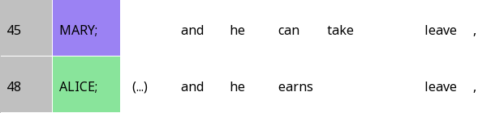

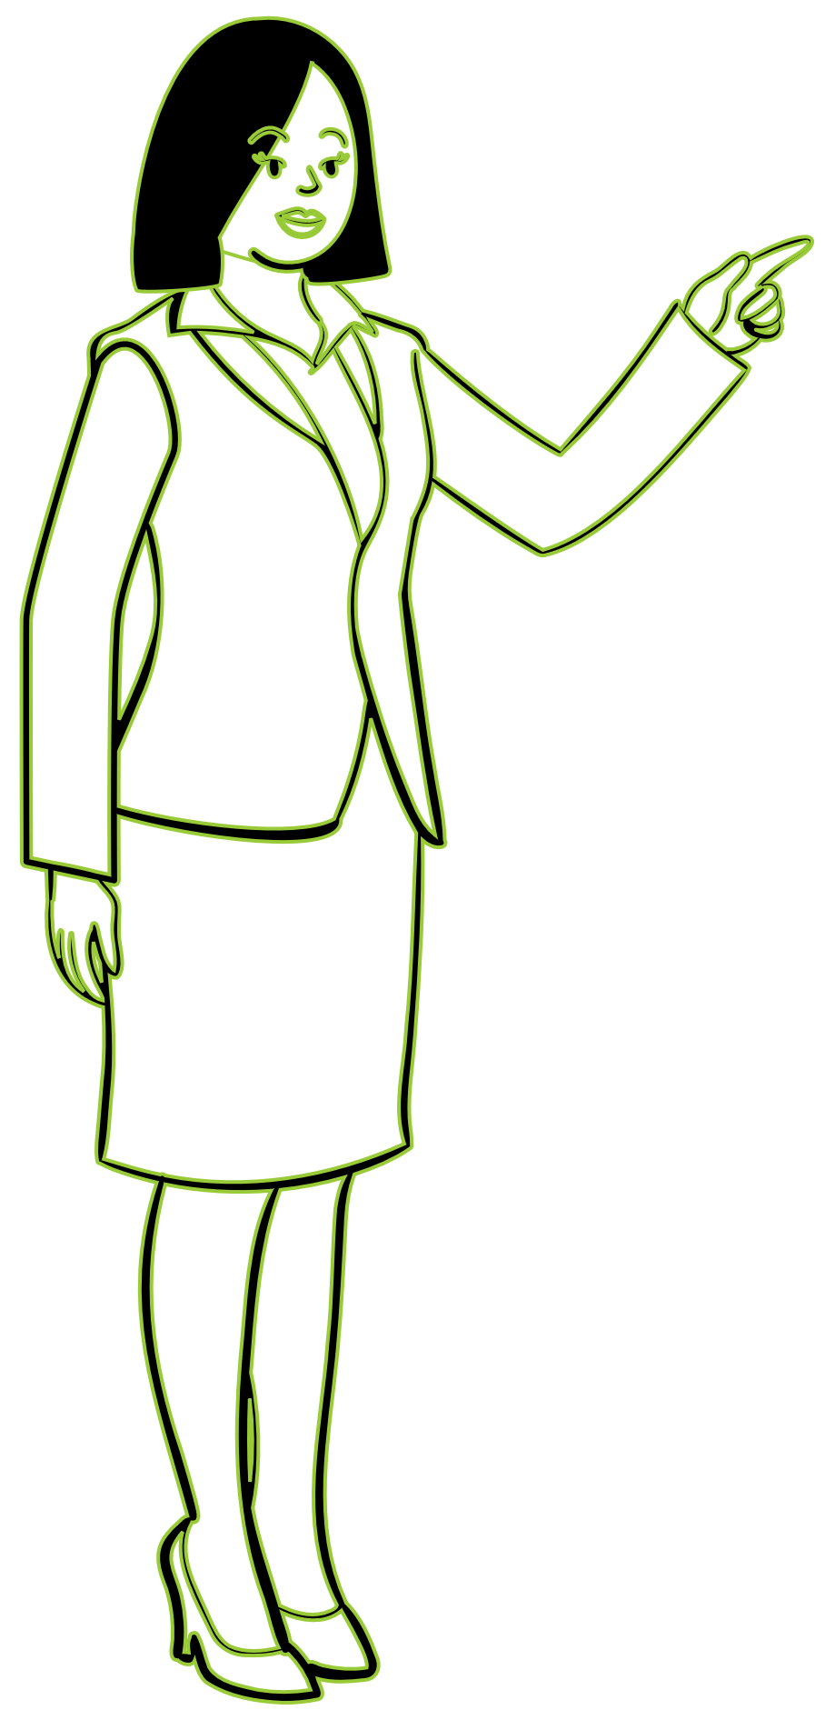
1. Priming
and he + verb + object

Slide 8
2. Reproduction

Slide 9
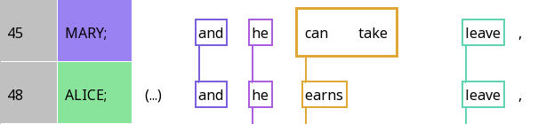
3. Resonance

Slide 10
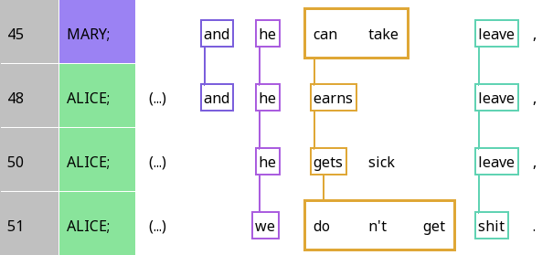
Frame resonance and focal resonance
Frame resonance: Resonance between identical elements or highly conventional correspondences

Slide 11
Frame resonance and focal resonance
Focal resonance: Resonance between elements that strongly contrast with the previous element, tell you ‘what’s new/different’

Slide 12
Frame resonance and focal resonance
Question: Which of the resonances between the third and fourth lines are frame resonances? Which are focal resonances? How does your answer differ from the relationships between the first three lines?

Slide 13
My analysis
Frame resonance
Focal resonance
Question: Which of the resonances between the third and fourth lines are frame resonances? Which are focal resonances? How does your answer differ from the relationships between the first three lines?

Slide 14
Diagraph
 | A | B | C | D | E
Mary | and | he | can take |  | leave
Alice | and | he | earns |  | leave
Alice |  | he | gets | sick | leave
Alice |  | we | don’t get |  | shit

Slide 15
Analysing analogies in focal resonance
 | B | C | E | C – interpretation
Mary | he | can take | leave | can – Possibility
Alice | he | earns | leave | -s – Habit
Alice | he | gets | leave | -s – Habit
Alice | we | don’t get | shit | don’t - Impossibility

Slide 16
Analysing analogies in focal resonance
 | B | C | E | E – interpretation
Mary | he | can take | leave | specific thing
Alice | he | earns | leave | specific thing
Alice | he | gets | leave | specific thing
Alice | we | don’t get | shit | anything

Slide 17

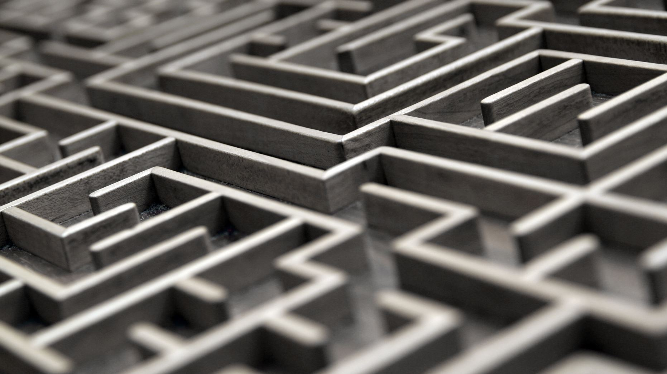



Annotating resonance in Rezonator

Slide 18
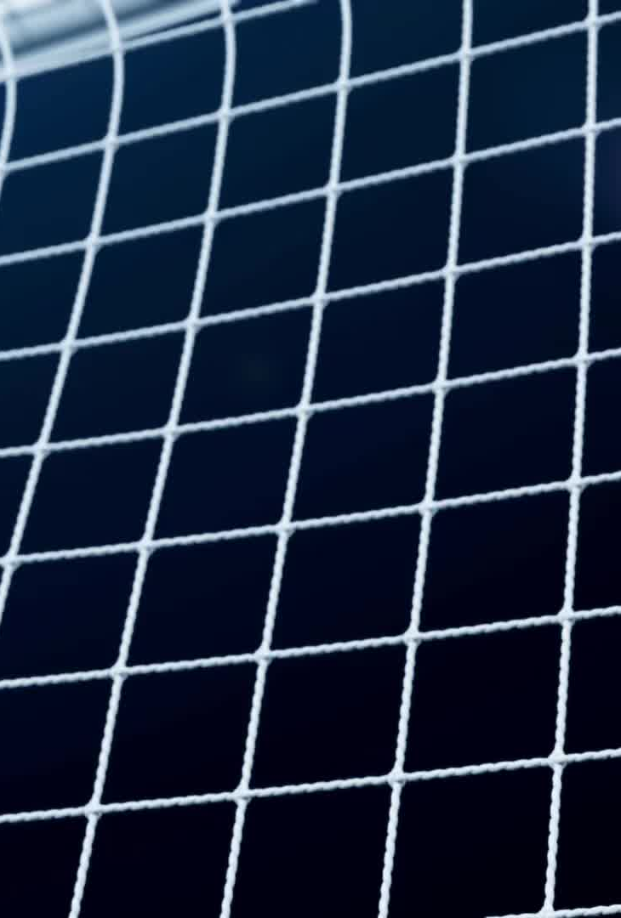
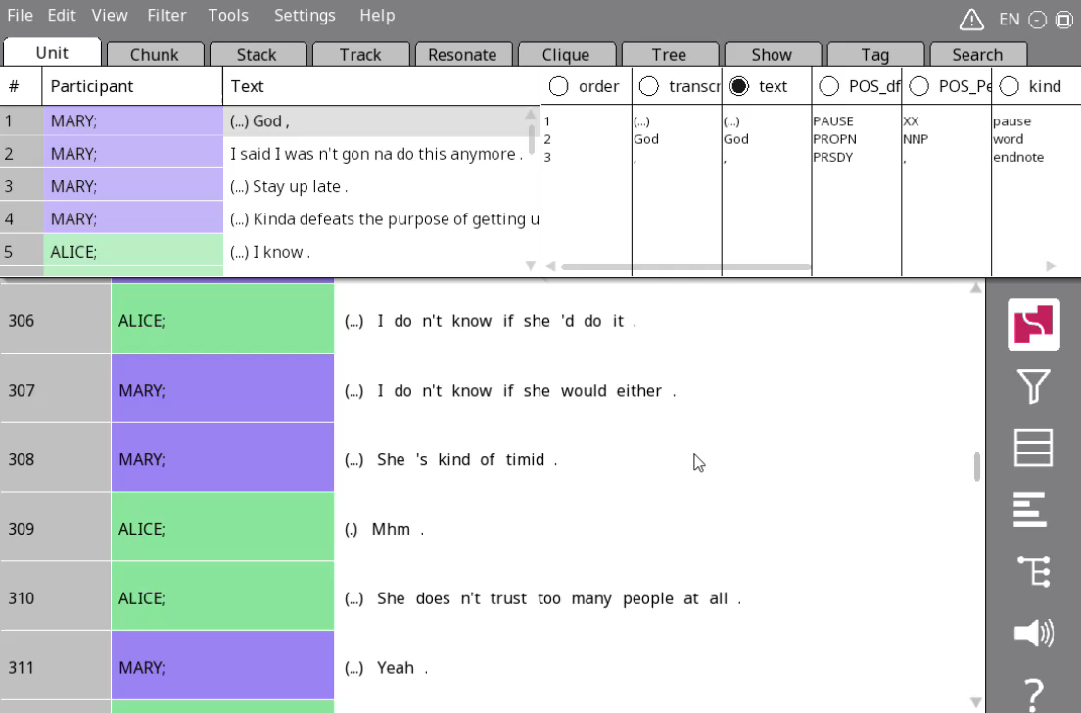


Resonance in Rezonator
Click the alignment button in the sidebar
Choose the left-justified grid view
Also choose resonance mode

Slide 19
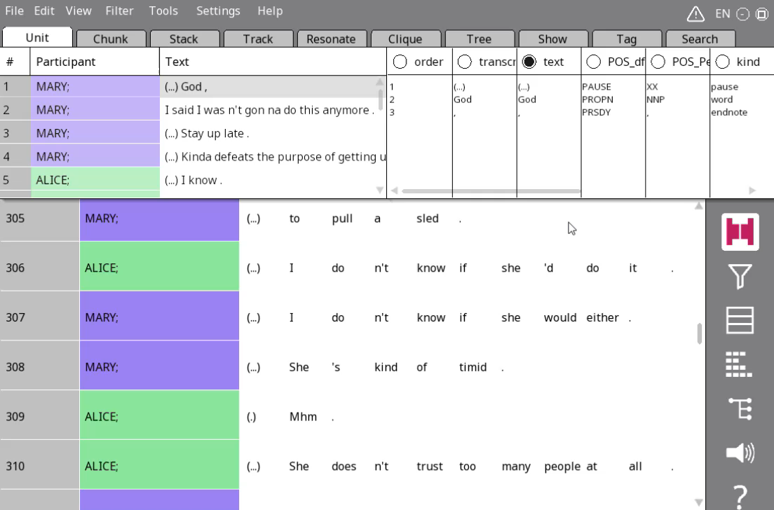

Annotating resonance – Method 1
Click on one word
Click on the resonating word
Go the Resonate tab and change names

Slide 20
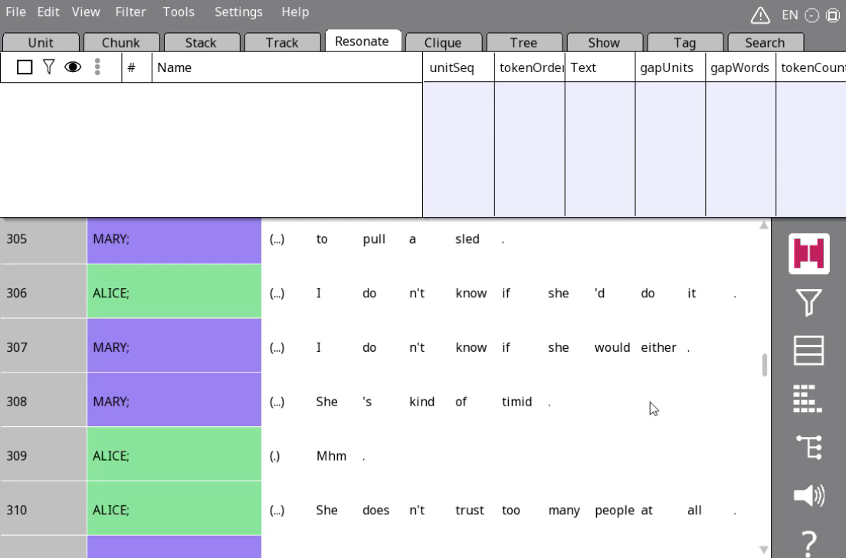
Annotating resonance – Method 2
Drag and drop on an area where the resonating words are already in the same column

Slide 21
Rezzes and resonances
Individual resonating words/chunks: Rezzes
Whole thing: resonance (chain)

Slide 22

Your turn!
Draw resonances in lines 1-12
Find examples of frame and focal resonance
Compare with your group members

Slide 23
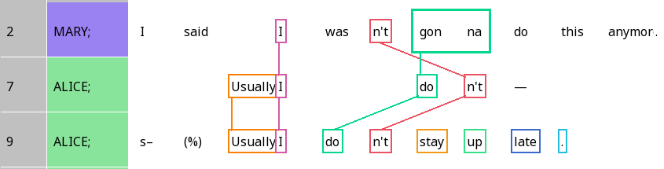
Crossed resonance
When the order of resonating elements is different across different lines

Slide 24
False start
Repeating structure to complete what you just said

Slide 25
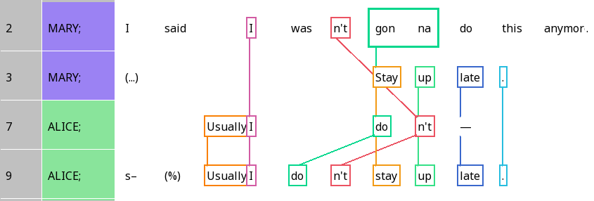
You can resonate with material from different lines!

Slide 26
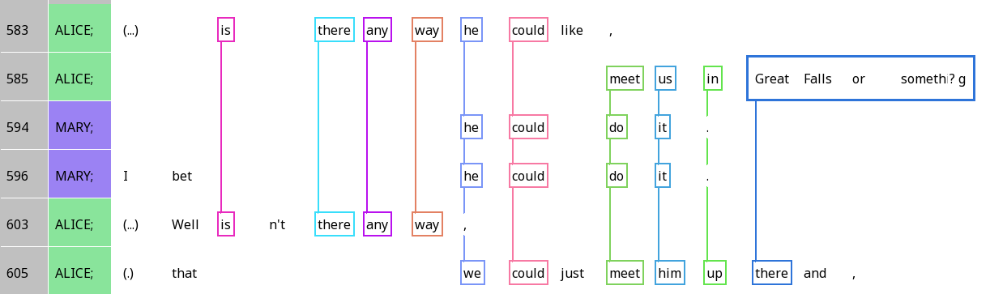
Resonance across IUs

